Slide 1
Event Driven Architecture
Team 1 MELJJ

Slide 2
What is it?
Event Driven Architecture is a software architecture paradigm promoting the production, detection, consumption of, and reaction to events.
Event can be defined as “a significant change in state”.
With an event-driven system, the capture, communication, processing, and persistence of events are the core structure of the solution.
Event-driven architecture enables minimal coupling, which makes it a good option for modern, distributed application architectures.
Notes:
Event-driven architecture is an architectural style where components in the system emit events and react to events.
It is used both internally within a single process and between processes.
It is widely used for GUI frameworks.
As mentioned before event driven architecture is mainly made up of events. It needs some type of response from user to keep the program going.
As mentioned, GUI frameworks typically use events a lot since they work through events within the program. For example it needs some type of event like a mouse event for the next action to happen.

Slide 3
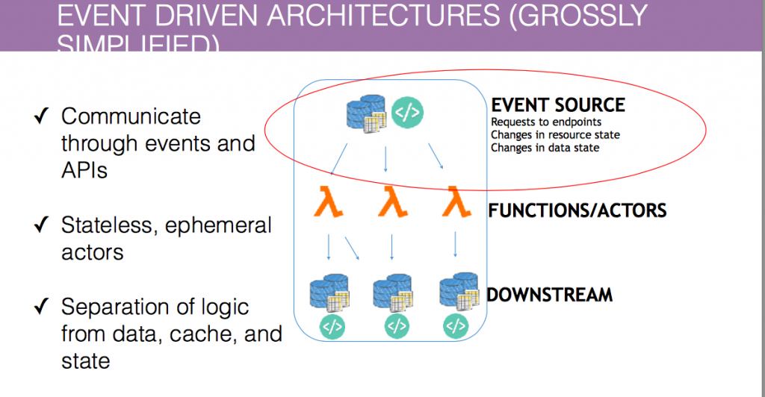
Notes:
This image simplifies what event driven architecture is.

Slide 4
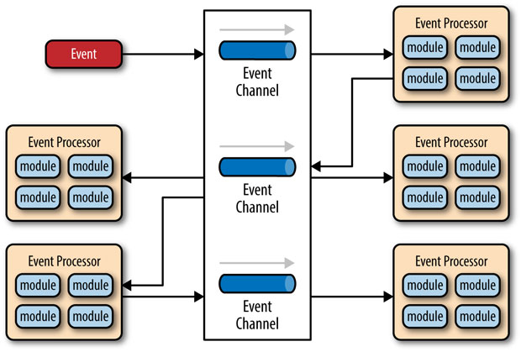
What Problem Does it Solve
Time delays, the architecture is action-reaction based.
Meaning that once a change of state happens in the system, the interested parties are going to get notified in real-time.
Modifiability/Extensibility
The ease of extending or the modification of the system.
Increasing Performance
Services do not have to keep requesting for status on the state of data, they subscribe to a topic where they get notified if the state changes.
Notes:
This architecture could minimize the time delays and enhances the performance, over something like a Request-Response model. In a Request-Response a component request some other component for information the component contains. To demonstrate the problem, suppose a component wants to know when a mobile device's battery gets below 20%. For accurate information on the battery, the component would have to request information every second or so; impacting performance significantly. However, in an Event-Driven model, the component that wants to know the battery would subscribe to the event bus topic, in this case, it would be the battery status. Now, when there is an event published in the event bus that signifies that the battery is below 20%, the component is going to be notified. The component would only wake up when it is notified of an event whose state indicates that the battery is below 20%.
This model allows the system to have services loosely decouple from one another. The services just subscribe to different topics and handle certain events. Having the event bus as the backbone of the system allows the modification of services to be easy; removing or adding services to the system. This is the case because the services are not communicating with each other, but performing logic on events they receive.

Slide 5
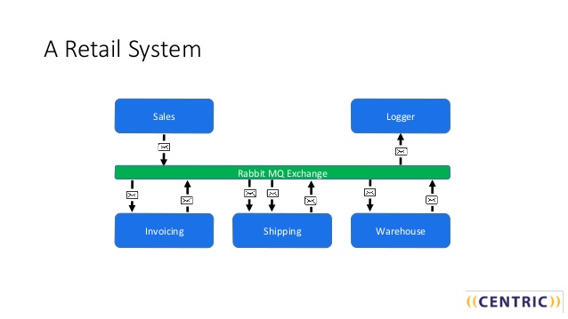
How does it solve the problem?
Services are not requesting for the state of the system.
The Event is triggered by a change of state, transfer to a mediator component; which transmit a Proccessable Event which triggers an action.
The Event Handler components are isolated from the system.
The Event Handler are going to receive an event from the mediator component and perform the logic on it; not being aware of the rest of the system.
Increased Performance
Events could be delivered asynchronously to the Event Handlers; no Event is waiting for another Event to process.
Notes:
As mentioned in the previous slide, the services or components are not going to be requesting and receiving a response to other components. Alternatively, they are going to subscribe to a topic and get notified once a particular event is published on the event bus. This increases the performance of the system significantly.
Event Handlers or Services are not completely isolated from the system. They are only aware of the events that are directed to them, by a subscription. Causing the modification of Event Handler or Services being an easy task.
As mentioned before, this kind of model is going to increase the performance of the system in comparison to a Request Model. The services should get notified when the state of the data they are interested in changes, not requesting and observing if it did change.
In the image, you can see a simple event-driven architecture for a retail system. Rabbitmq Exchange is an event broker, you could think about as a tool that helps you implement this architecture for a system.

Slide 6
Who are the actors? (i.e., main elements)
Event: a generated message
Has two components:
Header (metadata such as timestamp, ID)
Body (a description of the event that took place)
Event Generator or Publisher(e.g. a sensor)
Detects when message needs to be sent to Event Handler
Generates a message
Event Queue
First-in-first out structure
Is used to:
Track errors
Generate an event log
Monitoring
Event is passed onto the event queue

Slide 7
Who are the actors? (cont.)
Mediator
Receives events from event queue and transfers them to the event channel
Break up single events into multiple events and send them individually to their corresponding handlers/processors
Event Channel
Responsible for filtering and pre-processing events
Event handler/processor
Continuously listens to event channels and handles the event.
Notifies event queue that the event has been handled.

Slide 8
How do they relate to each other?
Event generator generates an event
Event gets sent through the event queue
Event then gets sent to the mediator where the event gets broken up and sent to corresponding event channels
Mediator sends event to the event channel where pre-processing occurs
Event channel is responsible to transmit message to the event handler
Event handler is responsible for handling the event and confirming that the event has been taken care of.

Slide 9
What are the strengths?
Improved competitive advantage:Event-driven architecture combines data-pattern identification with automatic alerts and notifications to the right people. This enables businesses to make operational decisions in real-time.
Greater operational efficiencies: The loose coupling of an EDA without affecting the layering, which makes for seamless, cost-effective operations.
Increased versatility: Event-driven applications are typically nonlinear and asynchronous, which makes them more adaptable. This enables components to function independently, allowing them to couple and decouple into networks, and be used and reused many times over.
Forecasting functionality: An EDA is particularly well-optimized to make use of real-time analytics. This makes it possible for companies to identify patterns that forecast events and prepare a response.
Notes:
As mentioned in before, event driven architecture works well for anything that combines data-pattern identification with automatic alerts and notifications. This means that the program will take real time data from users and present it for fast operational decision making choices.
Loose coupling is one of the biggest strengths of the EDA. this means that since it is loosely coupled it does not affect layering and is simpler to reach which reduces cost.
EDA is very versatile since it is loose coupled, is linear and asynchronous. This helps a lot during functions since they dont depend on another function to do its job.

Slide 10
What are the Drawbacks?
Security risks and increased complexity.
Testing is difficult since it is designed to anticipate the unknown but also may trigger the unforeseen and undesirable responses.
Hard to do error handling.
Notes:
EDA although it has many strengths it does contain some drawbacks. Especially within security and its increased complexity. We dont always know exactly whata components are part of the system and the dependencies between them due to its loose coupling.
Testing is extremely difficult to do in EDA which is designed to anticipate the unknown but also may trigger the unforeseen and undesirable responses.Since events are asynchronous there can be no anticipation of a specific order of occurrence or assured delivery of anything. Duplicates may occur in differing conditions that may each require contextual response.
Error handling is a hard thing to do in EDA. As event producers and event consumers proliferate it becomes more and more difficult to trace back activities occurring within and between them.

Slide 11
Examples
Event driven architecture shines in its’ versatility, more specifically in being able to handle multiple events in a asynchronous manner with efficiency and a higher degree of independence when compared with other systems. Examples of systems designed with EDA include motion sensors and remote controls. In the case of motion sensors, a user does not need to provide input directly to the system in order for the system to react accordingly. Motion activated lights would not need to be turned on and off for example, the system itself can turn on lights by utilizing motion sensors and reacting accordingly. EDA can also be applied to more intricate systems than sensors and controllers. Another benefit that comes with EDA is the fact that it is ideal for real time analytics, meaning that a system made with EDA is more enabled to be preemptive and a result better for preventing undesirable outcomes. A weather system for example would be able to utilize data it receives to advise denizens of an area to prepare accordingly in the event of harsh weather conditions.
Notes:
In summary, event driven architecture differs greatly from your usual request driven systems in the fact that it is more dynamic and versatile. In the architecture, an event producer and an event consumer are what makes this process possible, a producer spots an event and informs a consumer through an event channel, from there it is up to the event consumer to react accordingly.

Slide 12
Security Implications
Vulnerabilities-
As event driven systems have the possibility to be apart of distributed systems there is a likelihood of the attacker and the victim being objects of the same system.
There are ways to get descriptive data of available objects in the system telling you what applications are running meaning if any of the applications have any vulnerabilities that the attacker knows then they have another vector of attack.
Notes:
This slide goes over vulnerabilities such as the attacker has the possibility of being apart of the system and that you can guess easily what components are running from the objects.

Slide 13
Security Implications
When conditions enumeration and sending (normally used to modify running applications) are met any object can send events to any other object, this means that you can skirt around permissions and change objects and thus data that normally would be protected.
Under the same conditions above the interception of one way communication can be achieved as well allowing for situations like obtaining keycard information from a security program.
Notes:
This slide continues to go over vulnerabilities such as man in the middle object attacks and the ability to arbitrarily change objects after certain conditions are met.

Slide 14
Security Example
As event messages in some systems are limited in length you are able to cause a buffer overflow and execute arbitrary code.
One example is from Windows 2000 where WM_TIMER was in a address space that allowed access to other key systems and witch a bug was found.
The following is that code “PostMessage(hwnd_Victim, WM_TIMER, (WPARAM )0, (LPARAM )Ox76f7a3);” (Xenitellis, 2002)
Each one of these vulnerabilities can be fixed like most security vulnerabilities but they must specifically coded for to prevent.
Notes:
This slide provides an example of security vulnerability specifically the windows WM_TIMER overflow that allowed the arbitrary execution of code.

Slide 15
Sources
[1] https://www.redhat.com/en/topics/integration/what-is-event-driven-architecture
[2] https://www.youtube.com/watch?v=gIL8rW_eyww
[3] Xenitellis S. (2002) Security Vulnerabilities in Event-Driven Systems. In: Ghonaimy M.A., El-Hadidi M.T., Aslan H.K. (eds) Security in the Information Society. IFIP Advances in Information and Communication Technology, vol 86. Springer, Boston, MA https://link.springer.com/chapter/10.1007/978-0-387-35586-3_11
[4] https://www.tiempodev.com/blog/disadvantages-of-event-driven-architecture/
[5] https://systemsinnovation.io/event-driven-architecture/

